Slide 1

Improving quality in primary care: what have we learned so far?
Martin Roland

Slide 2


Slide 3
The conference said “No” to a Good Practice Allowance. Dr Wilson said that the Good Practice Allowance was political and provocative, prepared by a government whose main contact seemed to have been with philosophers and trendy professors.
BMJ 1986; 293: 1384-6

Slide 4
 |  | 1998 | 2009
CHD | Blood pressure ≤150/90 | 48% | 83%
 | Total cholesterol ≤5mmol/l | 17% | 80%
Diabetes | Total cholesterol ≤5mmol/l | 22% | 79%
 | HbA1c ≤7.4% | 38% | 55%
Campbell S et al. NEJM 2009; 361: 368-78

Slide 5
 |  | 1998 | 2009
CHD | Blood pressure ≤150/90 | 48% | 83%
 | Total cholesterol ≤5mmol/l | 17% | 80%
Diabetes | Total cholesterol ≤5mmol/l | 22% | 79%
 | HbA1c ≤7.4% | 38% | 55%
National guidelines
Audit and feedback
Public reporting
Annual appraisal
Opinion leaders
Financial incentives
Campbell S et al. NEJM 2009; 361: 368-78

Slide 6
Modest impact of P4P on quality of care

◆
❐

◆
QOF
❐
◆

Campbell S et al. NEJM 2009; 361: 368-78
Notes:
Here are the results of a study which we carried out in a representative sample of practices in England. We measured quality of care by going into the practices and extracting data from paper and electronic records at two points before the pay for performance scheme and two points afterwards. On the vertical axis you see the quality score against a set of predefined indicators. Look at the red line first. This is for coronary heart disease. You can see that care was already improving rapidly before the financial incentives came in. Following the introduction of incentives, care continued to improve at the same rate, and then it plateaued. It plateaued for two reasons: one was that the doctors had received all the money that they could get for these indicators, but the second is that for some of the indicators, care was probably as good as it could get. Now look at the yellow and the green lines. These are for asthma and diabetes. What you can see here is that care was again improving before the incentives, but the rate of improvement increased when the incentives were introduced. And then the improvement again plateaued. Now you may look at this and think “The incentives have only had a small effect” and you would be right. However, I want you to think about this in another way too.

Slide 7
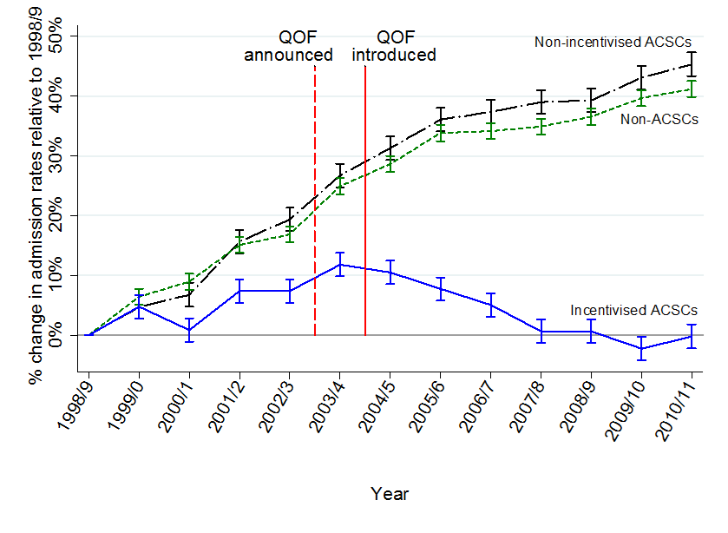
Did QOF influence outcomes?
Harrison et al BMJ 2014; 349: g6423

Slide 8
So what was good about QOF?
Increased pay and improved recruitment to general practice
World leading electronic records
Indicators largely related to aspects of care that GPs thought they should be doing anyway
Reinforced much good professional practice (which most practices were doing anyway)
Led to modest improvements in quality and some reductions in inequalities in the delivery of care

Slide 9
…. and what didn’t go so well
Introduction of indicators with little professional support (e.g. PHQ9)
Introduction of indicators which addressed a managerial rather than a clinical agenda (e.g. unplanned admissions DES)
No financial incentive
Increasingly irrelevant to the main workload (and quality) problems which were in the elderly with multiple complex problems

Slide 10
Percentage of NHS budget spent on general practice
England
Scotland

Slide 11
GP job stressors 1998-2015 (5 point scale, 1-5)
University of Manchester. 8th National GP Worklife Survey

Slide 12

“It’s the context, stupid!”

