Slide 1

A Learning health system
John Robson
GP
Long term conditions clinical lead Tower Hamlets CCG
Clinical Effectiveness Group lead
UCLP CVD primary care lead

Slide 2
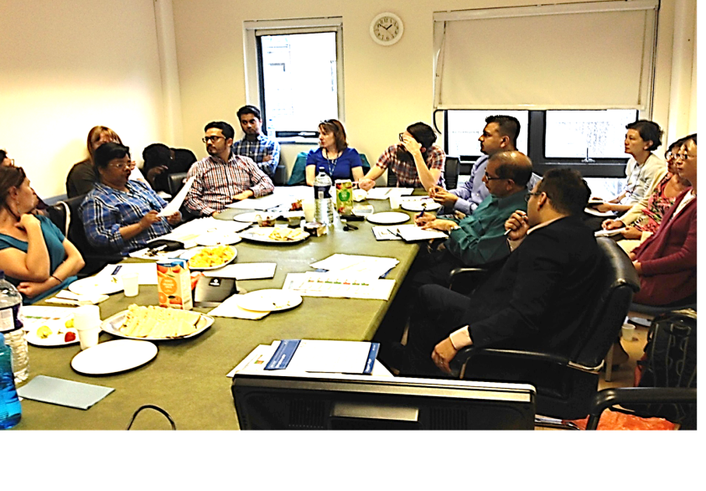
A Learning health system
Rag chart
Practice current
performance
Consultant
diabetes
Guideline

Slide 3
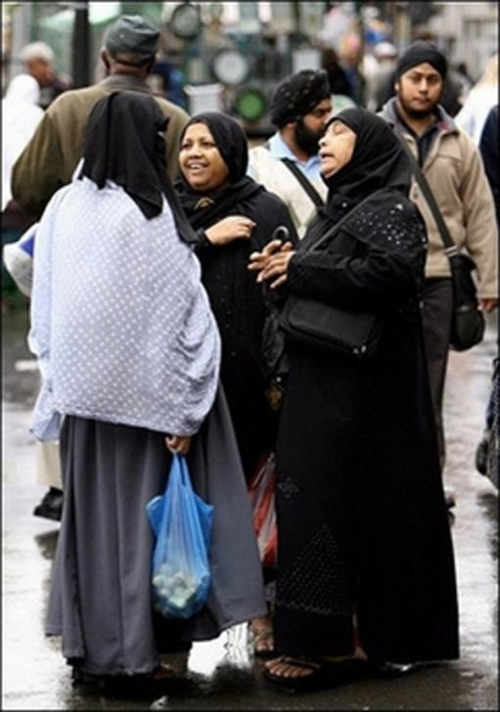
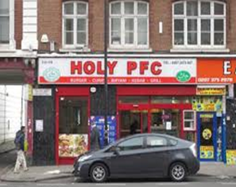
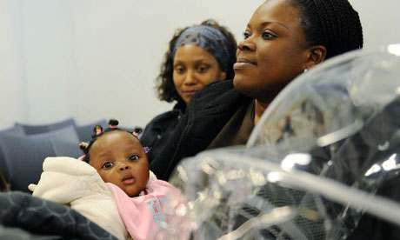
Welcome to East London
Notes:
Background
How does this apply to the populations where many of us work in inner London
Tower Hamlets has large proportions (30%) of south Asian residents,

Slide 4

East London Diabetes belt
1 in 20 have T2 diabetes
Waltham
Forest
Redbridge
Hackney
Tower Hamlets
Barking
Newham

Slide 5

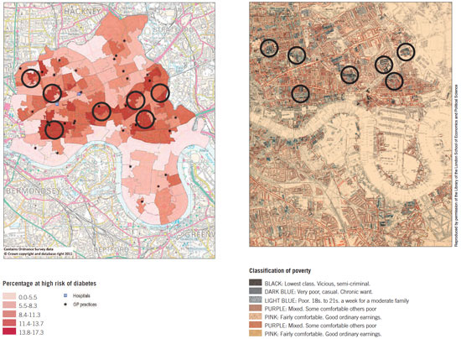
Whats new? 2015-1898
Lowest class vicious semi-criminal
Very poor, casual. Chronic want
………
Good ordinary earnings
Notes:
Rather like Americas deep South the legacy of poverty is a very long
The map on the right is by Charles Booth in 1898. It shows the poverty hot spots – in black & grey – compared and on the left is the same area in 2011 showing risk of developing diabetes with highest risk in– there is a striking similarity between areas of highest poverty and risk over time – the classifcation of povery has a surprisingly modern ring and Im sure many of those in Tottenham would recognise the phrases ‘Lowest class, vicious semi criminal’ . my practice is marked with the arrow

Slide 6
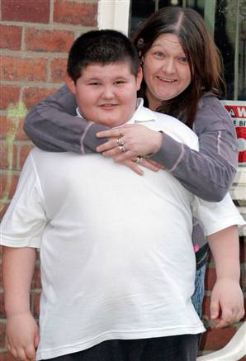
Where we are today
Male life expectancy 2002-9
NHS Tower Hamlets networks
Notes:
So where are we today? What can his young man expect?
Well in terms of male life expectancy at birth - East India ward, the ward in which I work has a life expectancy the same as albania and is closer to Iraq than it is to Japan.
I dont think this guy will fare much better –

Slide 7


National QOF Performance no exceptions. 2014/15
C&H
1st BP Target CHD, stroke, PAD 1st CKD BP 3rd Hyptn
1st AF anticoagulated (with exceptions)
1st COPD x spiro;MRC;FEV1 1st Asthma review
1st Diab exam; 2nd Diab eductn 3rd Diab BP 4th Diab cholesterol
2nd Dementia review
Tower Hamlets
1st Hyptn BP target 1st BP recorded in people >45 yrs 1st Diab BP 2nd CHD BP target
1st Diab cholesterol
3rd COPD spiro
Newham
3rd BP recorded >45 years; 3rd Diab Eductn 5th Asthma review 6th DM BP 9th Diab exam
Source: 204/15 QOF data

Slide 8


Slide 13
Practice IMD scores
http://fingertips.phe.org.uk/profile/general-practice
2014/15 QOF data

Slide 14
Practice IMD scores
http://fingertips.phe.org.uk/profile/general-practice
2014/15 QOF data

Slide 16
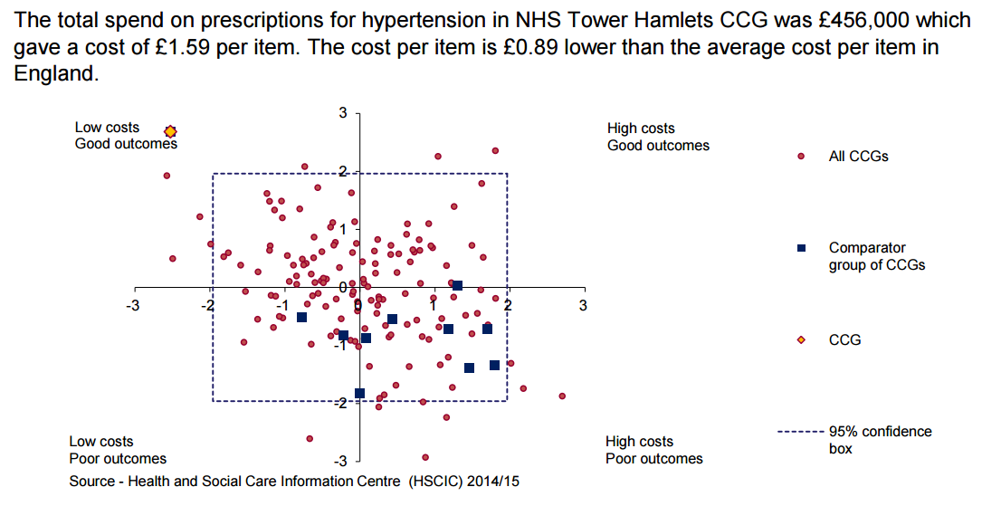
Hypertension: best control in England at lowest cost
TH
WF
Source: http://www.yhpho.org.uk/default.aspx?RID=185783

Slide 18
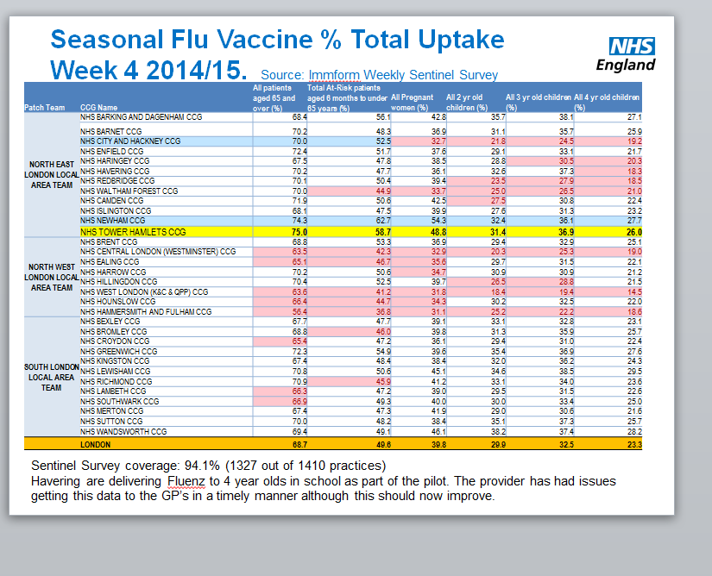
Flu vaccination 1st and 2nd best in London.
In 2011/12 Newham 18/31 THamlets 9/31

Slide 19
PROMIS: Early success+++
 | Jan 2014 | Sept 2015 | Relative change
High intensity statins >75 yrs | 27.5% | 35.7% | + 30% increase
High intensity statin <75 yrs | 11.0% | 14.0% | +27% increase
Quinolone/ceph as % all AB | 7.6% | 7.1% (1yr) | -7% decrease
% T2 diabetes on Long acting analogue insulin | 6.1% | 4.5% | -26% decrease

Slide 20
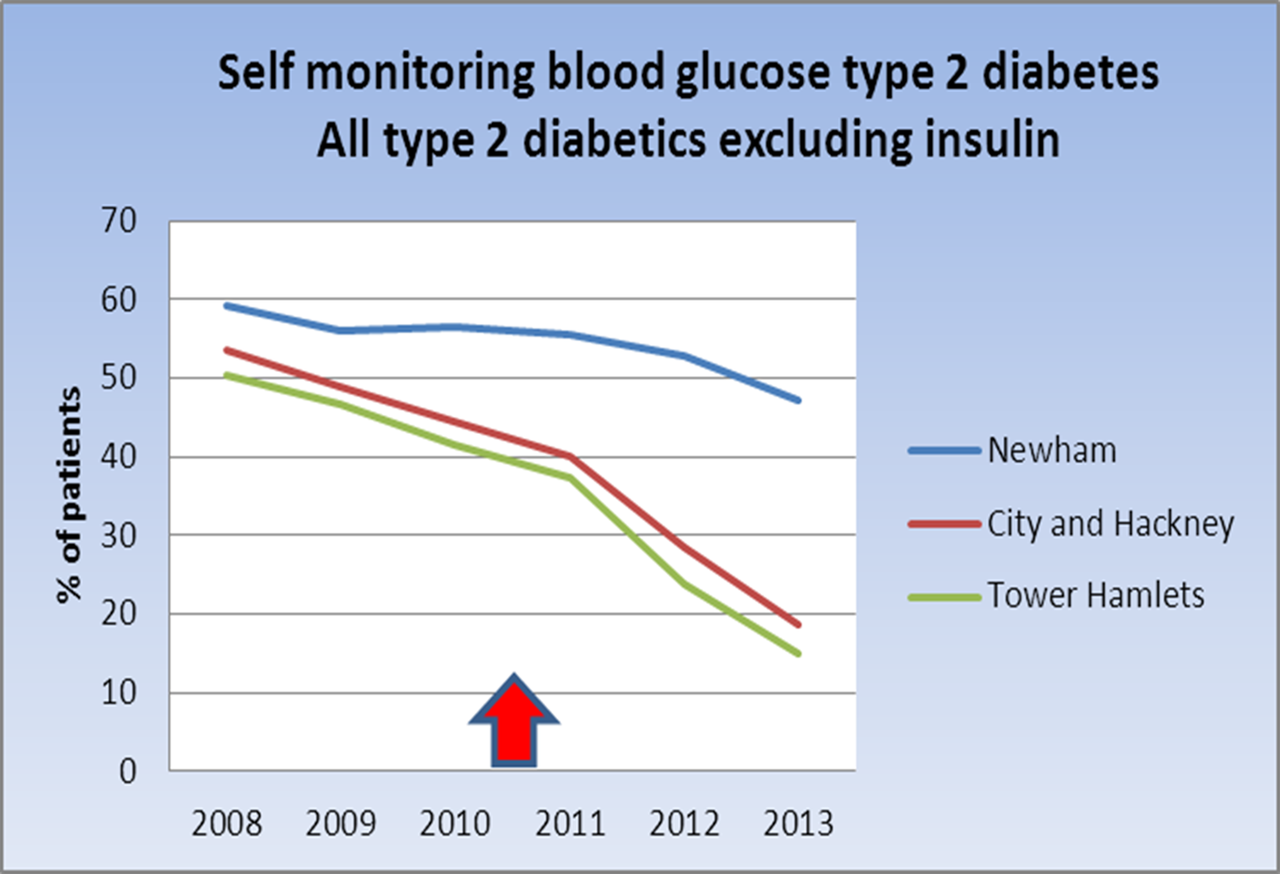
x
2014 2015

Slide 21
Achieving
Successful improvement

Slide 22
Single system IT
Web enabled
Central (& local) IT search and analysis capability
Locally engineered and responsive
CCG, GP provider and public health facing
(Academically supported)

Slide 23
Brain and spinal cord
Clinically led
Facilitators connect KPIs to practice implementation
Iterative work connecting analysts/facilitators/clinicians with CCGs/practices/public health
Choose wisely

Slide 24

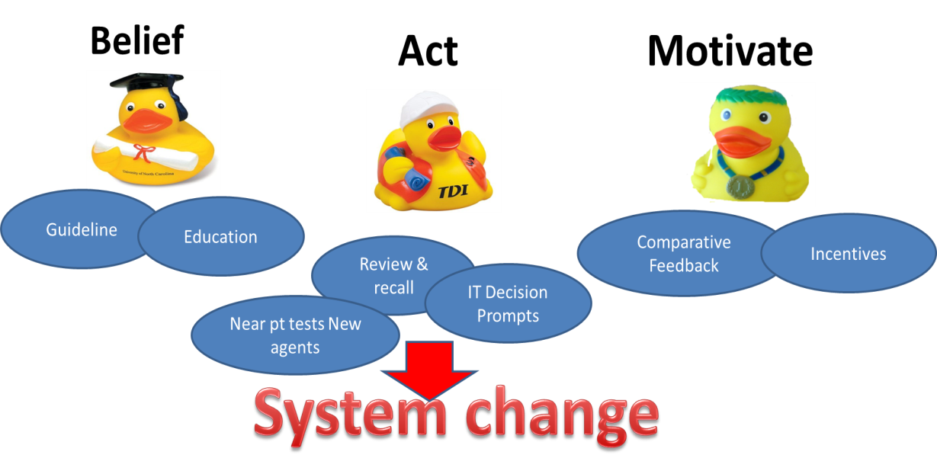
3 ducks in a row
Notes:
Model adapted and effectively applied to further CCGs over a short timeframe

Slide 25



Belief Act Motivate
Evidence
Stakeholders
Consensus
Guidance and KPIs
Education
IT support
On screen prompts
Script switch
Trigger tools
Patient recall
and review lists
Financial targets
Dashboards
Peer performance
Learning
Notes:
Not just improvement but learning

Slide 26
Stakeholder consensus and guideline

Slide 27
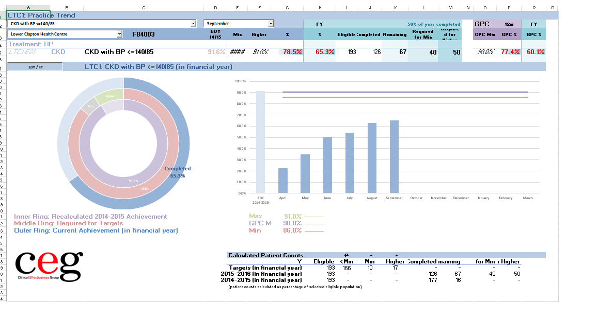
Dashboards: near real time

Slide 28
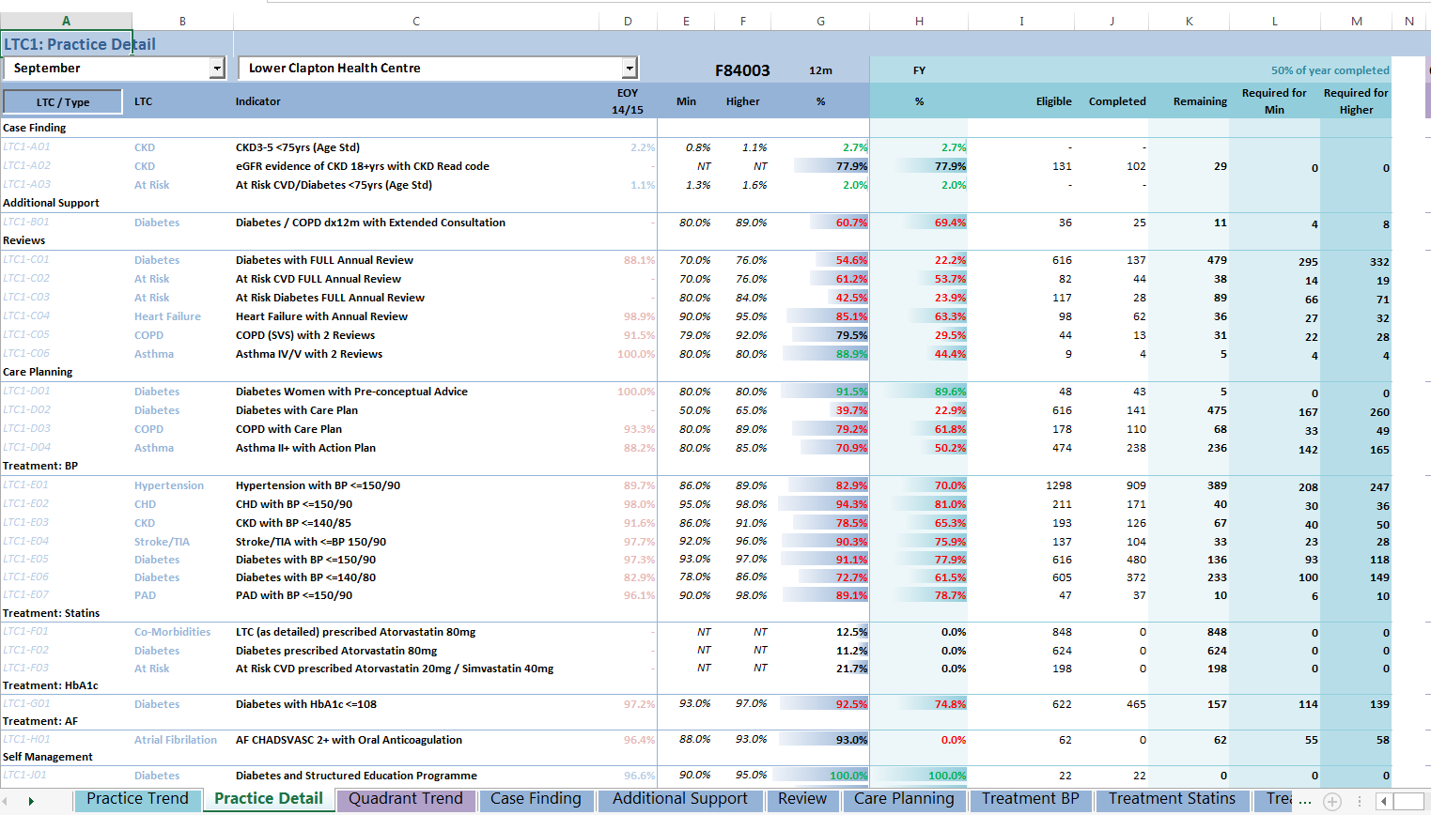

Slide 29
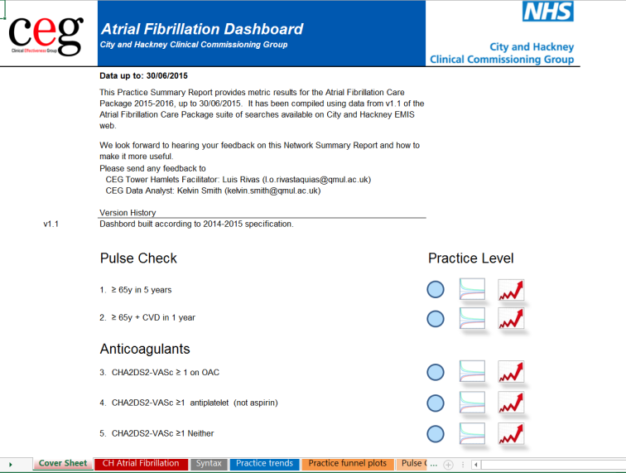
Dashboard

Slide 30
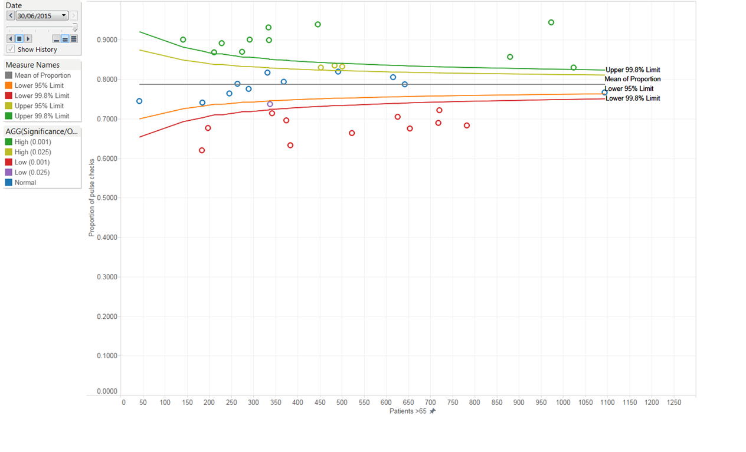
Pulse checks 65+ in 5yrs = 80%
Could do better

Slide 31

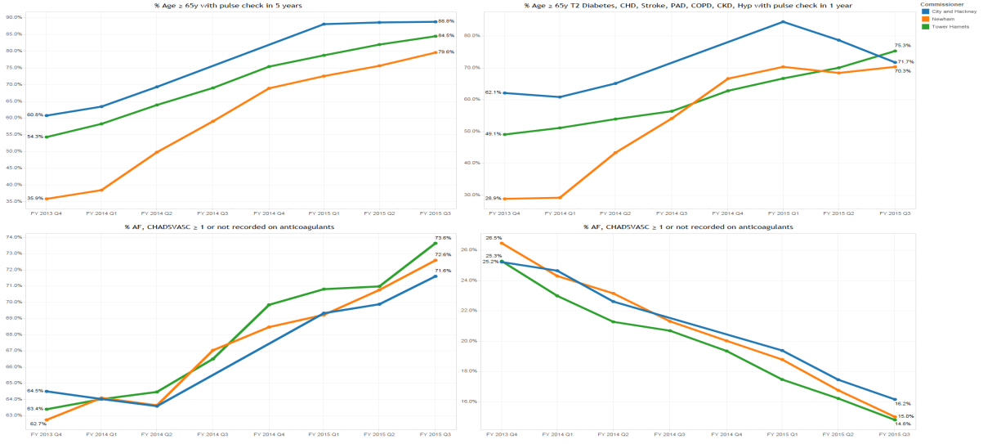
AF at Dec 2013-2015 C&Hackney Newham and Tower Hamlets- no exceptions
Pulse checks 65yrs in 5yrs Pulse check 65yrs comorbid 1 yr
90%
75%
80%
40%
40%
2013
Dec 2015
Anticoagulation CHADSVASC 1+
Antiplatelet CHADSVASC 1+
75%
25%
65%
15%

Slide 32
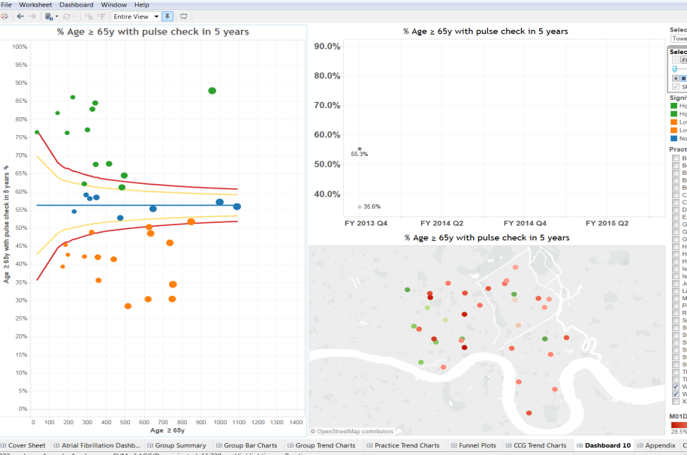
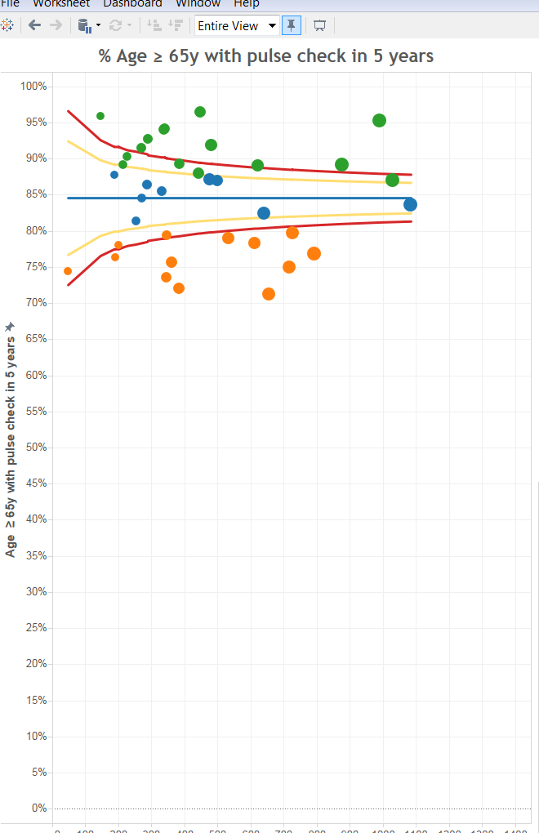
Funnel plots showing improvement 2013-2015. Tower Hamlets
2013
2015

Slide 33
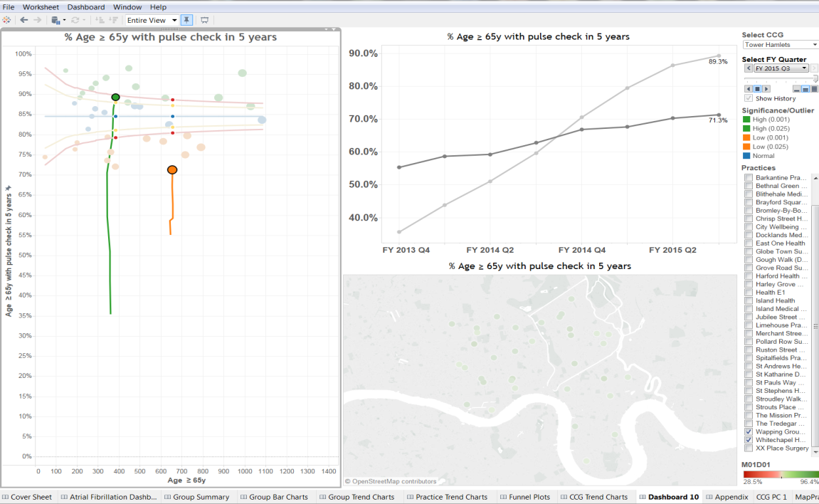

Slide 34
Choose wisely
SAFE NSAIDS, hypoglyaemia T2D 65yrs= 9%
EFFECTIVE AF anticg, hypertensn, h/i statins
EFFICIENT SMBG, LFTs, LAA insulin, antibiotic

Slide 35

Smarter working
Integrated care pathways – diagnosis, referral
4 cardiac symptoms
breathlessness,
chest pain,
palpitations
syncope/funny turns
Diagnostic templates
standard mail merged letters
Notes:
We are national leaders in IT and have a huge advantage of two major single systems – Cerner and EMIS – and we should do MUICH more

Slide 36
Smarter working
Multimorbid patient review : smart template
Trigger tools – CKD and VIRTUAL CLINICs;

Slide 37
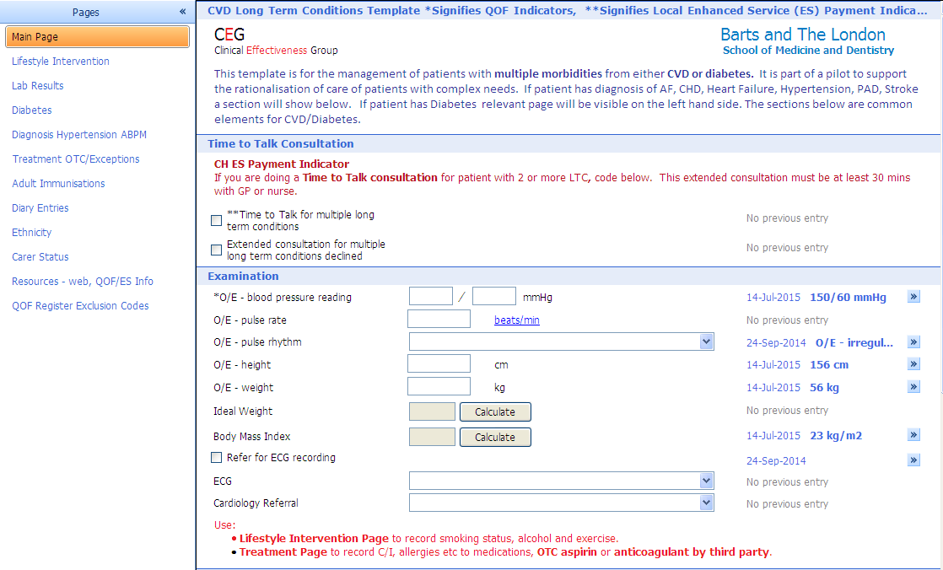

Slide 38
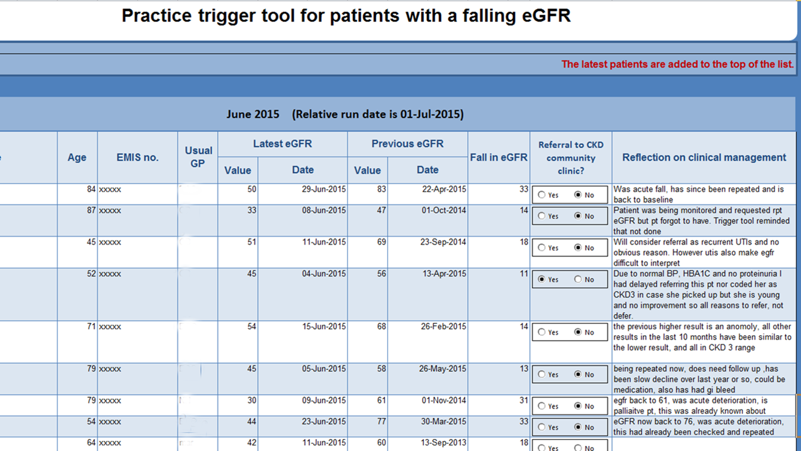

Slide 39
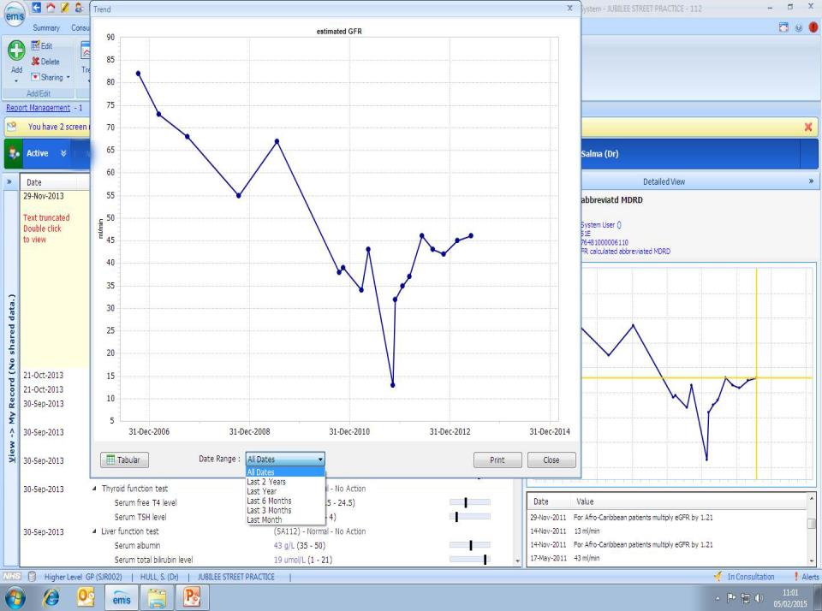
Notes:
Look at the patient record – in particular the eGFR graph

Slide 40
Reduction in full LFT array: increase in single ALT
£250,000 annually at the flick of a switch!!!

Slide 41
36 Practices in
8 neighbourhood networks
Neighbourhood Networks
53
23
Pop: 25,549
5
5
Pop: 38,529
20
6
3
6
19
1
2
21
22
26
4
27
Pop: 33,948
24
7
N6
8
10
9
14
25
12
13
Pop: 23,868
30
32
11
15
29
16
N7
31
28
17
Pop: 28,956
18
N8
33
36
35
34
*
Notes:
Our alternative to Darzi – connected geographical networks of local practice – typically 4 to 6
Paid for collectively achieving target
Specific targets in form of priority care packages

Slide 42
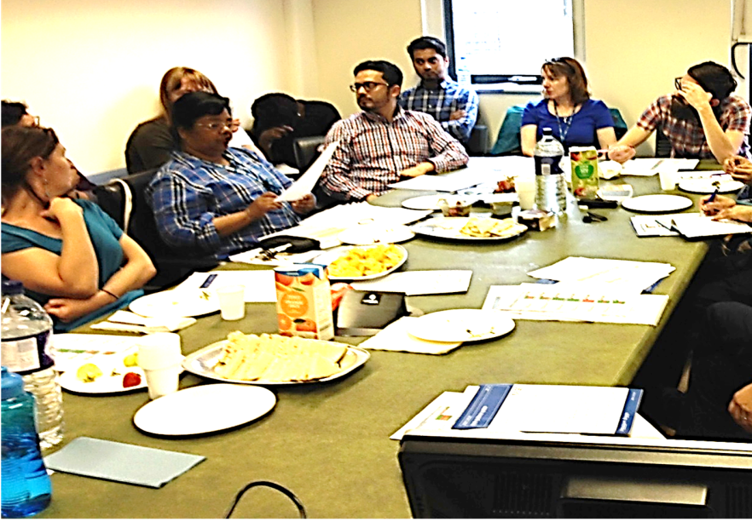

Slide 43
A learning health system
Compelling case for change
Finance to support change
IT enabled
Evaluation built in
Peer and organisational learning

Slide 44



CCG Resource
Resource | Cost per CCG | London cost (32 CCGs)
CCG clinical leadership 0.2wte | £27,650 | £884,800
CCG Practice Facilitator 0.2wte | £9,870 | £315, 830
IT licence and data analysis | £18,250 | £584,000
TOTAL | £55,770 | £1,784,630
Stakeholder engagement
Education
Use existing IT effectively
Decision support, recall lists
Peer performance dashboards, targets, incentives

Slide 45


A learning health system
Diabetes
CVD
Imms
COPD
2008
bottom
quartile
performance
4 yrs
top in UK
and London

Slide 46

Next steps for a learning health system
People
Trusted
Health systems
Data
service
Responsive
Social services
3rd party
uses
Effective
East London
Data service

Slide 47
Record views
Predictive
scores
Clinical Decision support
Historical
reports
Interactive Dashboards
Clinical data exchange
Quarterly
reports
Patient connected
aps
Commissioner provider patient
Reactive unlinked proactive linked real time

Slide 48
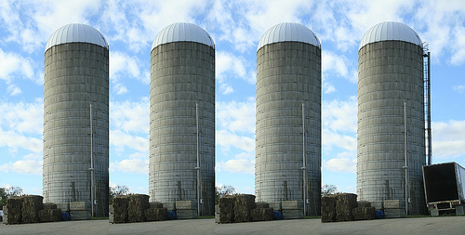
Social
Services
EMIS
CERNER
HSCIC

Slide 49


Slide 50
Our Dataservice (popn~2m) clinical as well as third party
Near real time reporting
Outcomes relate to process – bleeding in NOACs vs warfarin
- hip replacement failure
- safety – hypoglycaemia; renal function
Efficiency – no duplicate tests
Predictive scores
Decision support
Research
Patient connection
Social services, OOH, 111 etc ………….

Slide 51
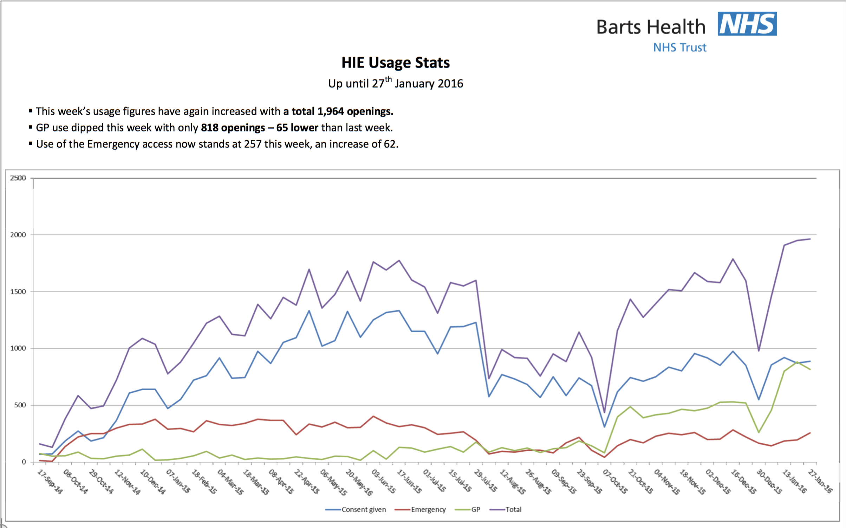



East London Shared Record-Progress & Emerging Benefits
HIE Upgrade v12
#CollectShareUse

Slide 52
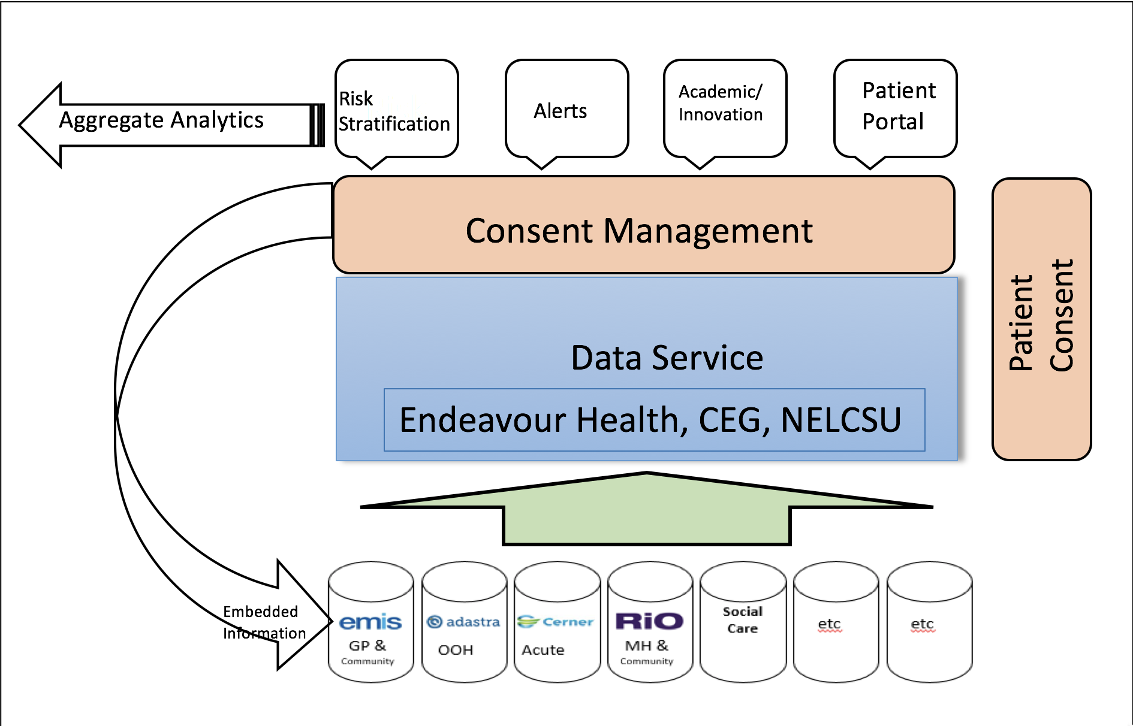
Dataservice

Slide 53

May the ducks be with you …

