Slide 1
How Quality Circles work across Europe
Adrian Rohrbasser,
Family physician, trainer and tutor of facilitators, member of the committee for quality in primary health care in CH and delegate in the European Society of Quality and Safety in Family Medicine (EQuiP).
DPhil Student University of Oxford, Department of Continuing Education / Primary Care Health Sciences
adrian.rohrbasser@bluewin.ch

Slide 2
Quality Circles (QC) in Primary Care
''Small Groups of Health Care Professionals who meet at regular intervals to increase and disseminate knowledge'‘

Slide 3
Do QCs work?
'‘measured Q''
“Components of QCs”
Change in prescription habits (Welschen, Kuyvenhoven et al. 2004; Niquille, Ruggli et al. 2008, Bugnon, Jotterand et al. 2012; Wensing, Broge et al. 2009)…
« Inappropriate prescribing »(Brekke, Rognstad et al. 2008)
Change in test ordering (doctors become more specific)(Verstappen, van der Weijden et al. 2003, Verstappen, van der Weijden et al. 2004)
................
Facilitation(Dogherty, Harrison et al. 2010, Baskerville, Liddy et al. 2012)
Audit and feedback (Ivers, 2012)
Use of local opinion leaders(Flodgren, Parmelli et al. 2011)
Workshop (O'Brien, Freemantle et al. 2001, Forsetlund, Bjorndal et al. 2009)
Outreach visits (O'Brien, Rogers et al. 2007)
Printed Educational Material (Giguere, Legare et al. 2012)
Guidelines (Thomas, Cullum et al. 2000)

Slide 5
Loops
WHAT AND HOW: description of the process
Loops
Shared understanding of a problem
Manage conversations: share tacit knowledge
Make it explicit and Create new concepts
Test the new idea
Systematic Use of Knowledge: make it implicit
Justify these new concepts
Building a prototype: create new knowledge

Slide 6
CIRCUMSTANCES: Enabling context
Mutual trust
Active empathy
Access to help
Lenience in judgement
Courage

Slide 7
CIRCUMSTANCES: Supporting the group process
Size of the group
Composition of the group
Do not have barriers (PC, tables,….)
Safe environment
Protected time
Umbrella organisation

Slide 8
Other potential benefits
Job satisfaction
Attractiveness of the job
Continuity of staff
Professional Development: status of Family Physicians

Slide 9
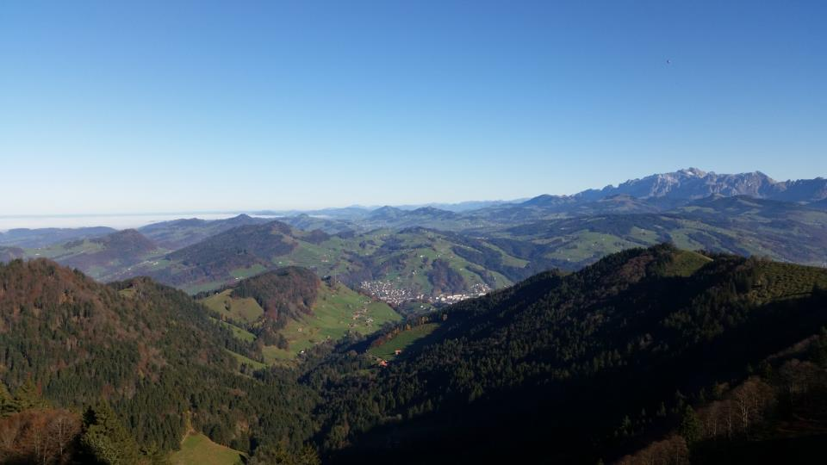
THANKS !
? QUESTIONS ?

