Slide 1
Evaluability assessment – a systematic approach to the planning of evaluation projects
Peter Craig
Department of General Practice, University of Glasgow, 19 February 2016

Slide 2
What is evaluability assessment (EA)?
A systematic approach to the planning of evaluation projects
  Engage stakeholders
  Clarify intervention goals
  Develop a theory of change
  Decide whether a useful evaluation can be carried out at reasonable cost
  ‘A low cost pre-evaluation activity to prepare better for conventional evaluations of programmes, practices and some policies.’ (Leviton et al., 2010)

Slide 3
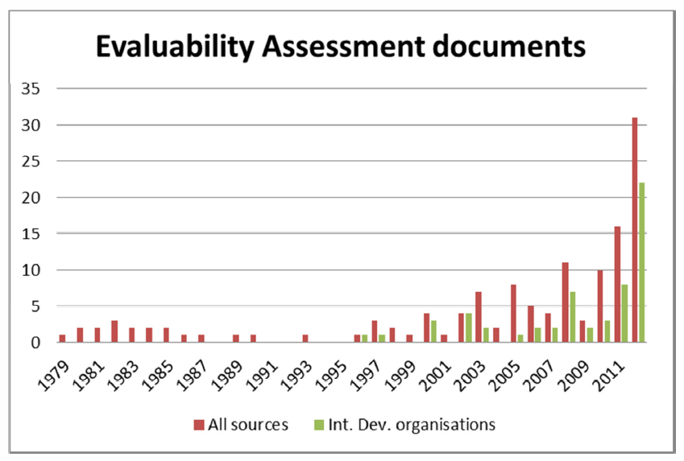
How have EAs been used?
Developed in the US in the 1970s, in response to the failures of evaluation of the ‘Great Society’ programmes in the 1960s and early 1970s
Applied by a number of US government agencies before falling out of favour
In the UK, mainly used by aid agencies to evaluate development projects (Davies, 2012)
Recent interest in using EA to evaluate public health interventions, e.g. Healthy Towns initiative (Ogilvie et al., 2011), Responsibility Deal (Petticrew et al., 2013)
Two EAs have recently been completed in Scotland

Slide 4
What can EA offer?
Clarify intervention goals and likelihood of measurable impact, before resources are committed to a full scale evaluation
Avoid committing evaluation resources if there is little realistic expectation of benefit
Enable constructive engagement with stakeholders, whether or not a full scale evaluation is undertaken
Make the evaluations that are undertaken more useful

Slide 5
Process
Convene working group
Develop and agree a theory of change
Review existing literature
Identify data sources
Develop and appraise evaluation options
Report

Slide 6
How do you do an EA?
Convene working group
Workshop(s) to agree ToC
Analysts
Draft report
Investigate data sources
Literature review
Revise ToC
Agree next steps
Develop options
Choose preferred option
Identify resources
Develop project plan
Publish report
Select team; agree roles
Preparatory work on data sources, existing literature, Toc, etc.
Implementers
EA working group
Policy makers
Etc.
Month 1
Month 2
Month 3
Month 4

Slide 7
An example: the Family Nurse Partnership in Scotland
Structured home visiting intervention to improve health and social outcomes for young first-time mothers
Developed in the US, and evaluated in RCTs in the US, Netherlands and England
Implemented under licence in Scotland, following a feasibility study
EA involved
  Review of previous research, including US trials, and the ongoing trial in England
  Review of routinely collected data on pregnancy, maternal and child health outcomes in Scotland
  Three workshops with policy makers, practitioners and analysts.

Slide 8
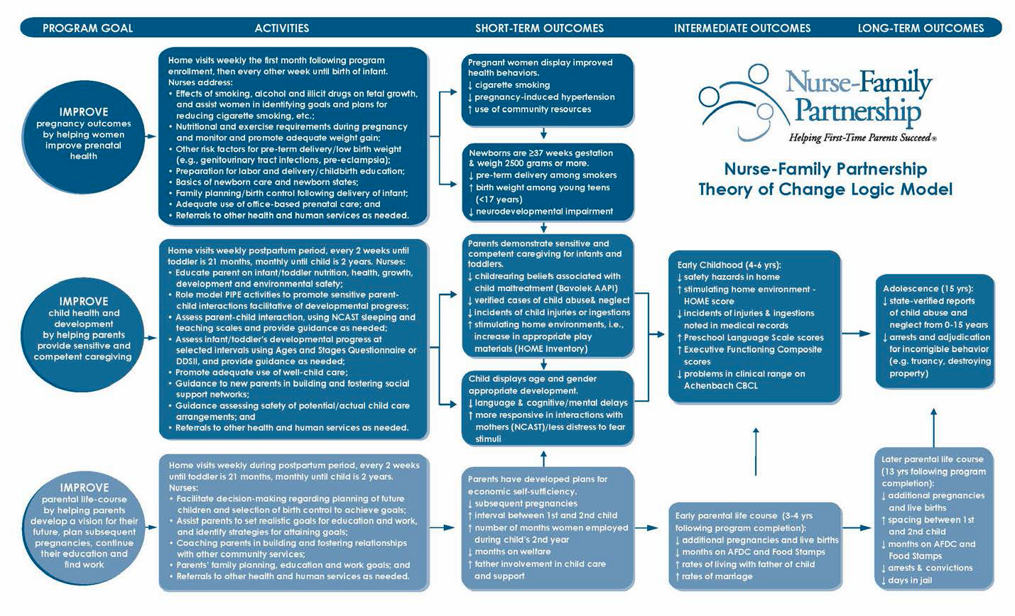

Slide 9
Simplified theory of change for FNP
FNP workforce, resources, training, implementation support
Support and supervision
Program engagement & completion
Improved self-efficacy
Future pregnancies
Health behaviours
Relationships
Parenting
Better outcomes for mothers
Education,
Employment
financial self sufficiency, physical and mental health
+
Therapeutic relationship with mother
+
Improved pregnancy/birth outcomes
Better mother-child attachment
Better outcomes for children
Improved child development
Less neglect/ maltreatment
Use of tools and guidance
Impacts on HV and early years practice
Impact on public services
Notes:
NB Can’t directly observe the arrows; can only infer from relationships between the items in the boxes.
(So not so important to include all the arrows!)

Slide 10
Data sources on births to young mothers in Scotland
Theory of Change | Data sources
 | FNP dataset | ISD* | GUS
FNP Programme delivery | ✓
Programme engagement % eligible pop reached Completion rate Attrition rate | ✓ ✓ ✓
Improved self efficacy Health behaviours Future pregnancies Relationship with father | ✓ ✓ ✓ | ✓** ✓ | ✓ ✓ ✓
Improved life circumstances Education Employment Financial self sufficiency | ✓ ✓ ✓ |  | ✓ ✓ ✓
Improved maternal health General health status Mental (anxiety, depression) | ✓ ✓ | ✓*** | ✓ ✓
Pregnancy outcomes Gestation Birth weight Birth experience | ✓ ✓ ✓ | ✓ ✓ ✓
*Includes the SMR02 maternity record, child health programme, Scottish Immunisation & Recall System (SIRS) and childhood hospital admission data.
**Smoking during pregnancy
**Hospitalisation for mental health problems

Slide 11
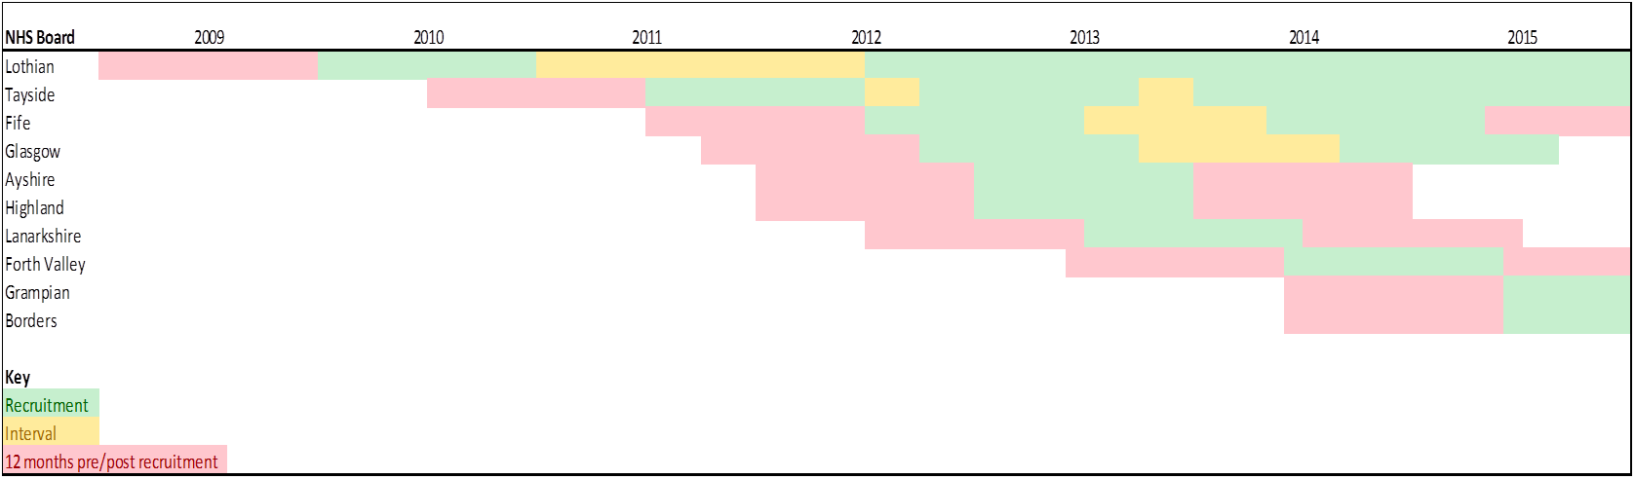
Recruitment to FNP by NHS Board Area in Scotland

Slide 12
Evaluation options for FNP
Continue as now, with enhanced analytical plan to identify predictors of variation in outcomes
As 1, plus cluster-randomised controlled trial of FNP vs. standard home visiting practice
As 1, plus natural experimental study comparing participants with eligible non participants (‘interval births’) and/or nearly eligible non-participants (e.g. first time mothers aged 20).
Realist evaluation – what works for whom in what circumstances and why?
Pros
Stop-start recruitment should ‘balance’ participants and non-participants
Range of methods for identifying impact and testing for bias
Much larger numbers available than in a randomised trial
Partly retrospective so results available relatively quickly
Relatively cheap
Cons
Choice of outcome measures constrained by routinely available data
Analysis more complicated than in a randomised trial
Relatively novel, so may lack credibility of a randomised trial
Individual-level linkage required – would approval be granted?

Slide 13
Recommendations for FNP evaluation
Natural experimental approach strikes the best balance between practicality, cost and usefulness
Should include a thorough theory-based process evaluation and an economic evaluation
Impact on services would require an additional study with a different focus and methods

Slide 14
What lessons have we learnt?
Policy makers like them
understand their own programmes better
understand the constraints on evaluation design, and what an evaluation can and can’t deliver
Researchers benefit from
shared understanding of ‘programme theory’ and constraints on evaluation design
EAs most useful when
resources have already been earmarked for evaluation, but …
… there is genuine uncertainty about whether and how best to evaluate
The method is flexible
The process needs to be adapted according to the stage of development of the intervention

Slide 15
Over to you!
Develop a theory of change for the case study intervention, linking intervention components with key outcomes
Consider what data sources could be used to measure changes in those outcomes
Think about what kind of research design would allow you to
  Identify the impact of the intervention
  Understand the process by which change is achieved

Slide 16
Further reading
Peersman, G., Guijt, I., and Pasanen, T. (2015) ‘Evaluability Assessment for Impact Evaluation’. A Methods Lab publication. London: Overseas Development Institute. (www.odi.org/methodslab)
Davies, R. (2013), ‘Planning evaluability assessments - A synthesis of the literature with recommendations’. London: Department For International Development (http://bit.ly/1eFbd4u)
Dunn E. (2008), ‘Planning for cost effective evaluation with evaluability assessment’ . Washington, DC: USAID (http://pdf.usaid.gov/pdf_docs/PNADN200.pdf)
Leviton, L. C., et al. (2010). Evaluability Assessment to Improve Public Health Policies, Programs, and Practices. Annual Review of Public Health 31: 213-233
Craig, P. and Campbell, M. (2015). Evaluability Assessment: a systematic approach to deciding whether and how to evaluate programmes and policies. What Works Scotland. (www.whatworksscotland.org)

